Slide 1
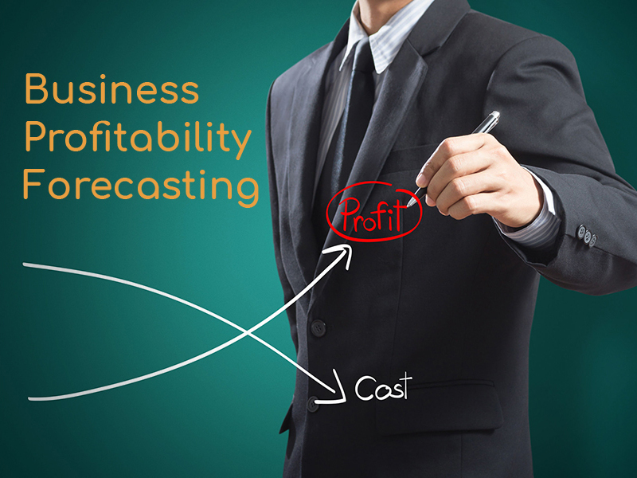


How to take Maximum PROFITABILITY from VESTIGE Plan
The Team of Champions
By: MANOJ PRAJAPATI, UCD

Slide 2
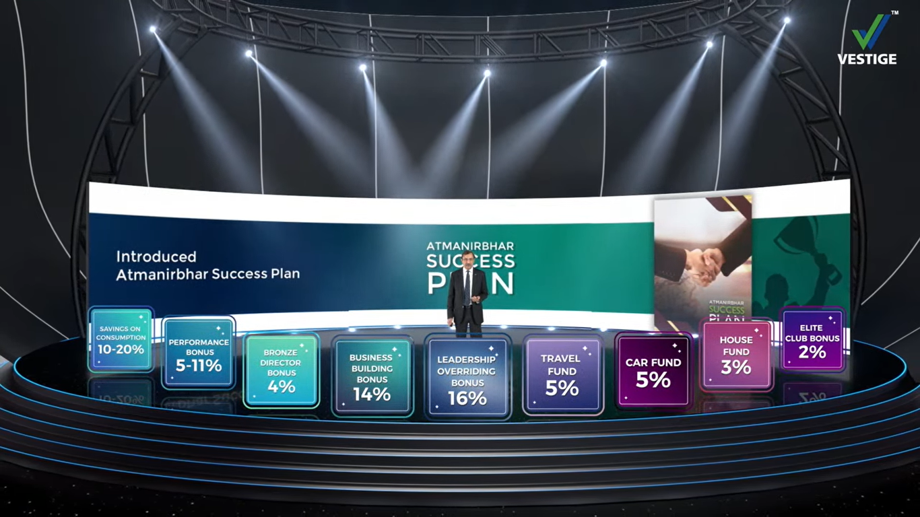
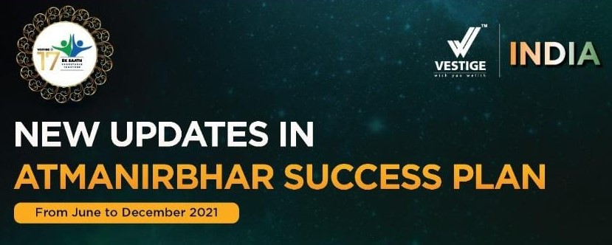

New Funds
Team Building Bonus
2%
Pool Income
1%
3%
17%

Slide 3
Vestige Leadership Levels and Type of Income/Level
Bronze Director – 5501 PV Cum. &
2001 PV in QM
Crown Director – 6 Leg Qualified
6 Type Income – PB, BBB, TF LOB, CF & HF – 6 L
3 Type Income – PB, BDB & TBB – 0 L
Universal Crown Director – 8 Leg Q
Silver Director – 1 Leg Q + 1801 SV
7 Type Income – PB, BBB, TF LOB, CF, HF & ECB – 7 L
4 Type Income – PB, BBB, TBB & LOB – 2 L
Double Crown Director – 12 Leg Q
Gold Director – 2 Leg Q + 1501 SV
7 Type Income – PB, BBB, TF LOB, CF, HF & ECB – 8 L
4 Type Income – PB, BBB, TF & LOB – 3 L
Double Universal Crown Director – 16 Leg Q
Star Director – 3 Leg Q + 1001 SV
7 Type Income – PB, BBB, TF LOB, CF, HF & ECB – 9 L
5 Type Income – PB, BBB, TF LOB & CF – 4 L
Diamond Director – 4 Leg Q + 501 SV
Self Purchase = 150 PV as CORE
5 Type Income – PB, BBB, TF LOB & CF – 5 L

Slide 4
We are 60% and 40% Partnership with Vestige
Company Total Distribution : 11 + 4 + 2 + 14 + 16 + 3 + 5 + 3 + 2 = 60 %
Actual Cash Distribution: Company Distribute 60% of its Turnover
60% of 60 = 36% Cash Distribution
Total Distribution of Your Rs. 100/-
49.2%
Training & Infra Extra
Company New Distribution are: 11 + 4 + 2 + 14 + 17 + 3 + 5 + 3 + 2 + 1
= 62 %
Actual Cash Distribution: Company Distribute 60% of its Turnover
62% of 60 = 37.2% Distribution
In Addition to Product Gift = 10%
Consistency Gift = 20%
30 % का
40% = 12%

Slide 5
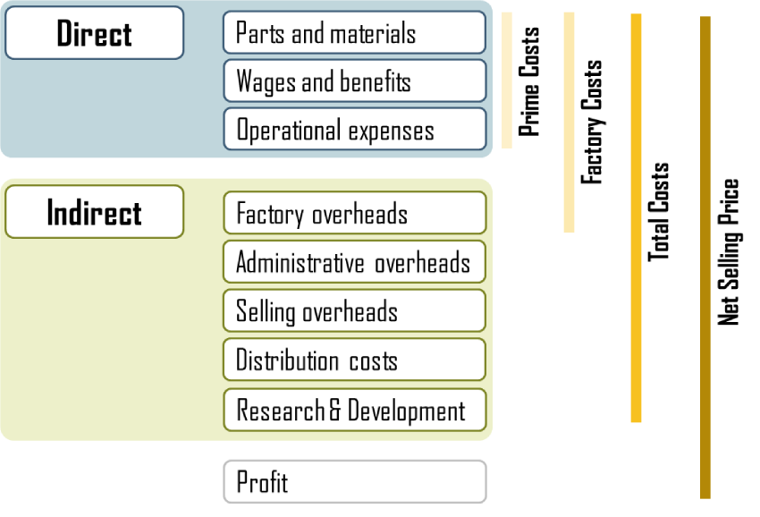


Company Profit on your Rs. 100/- Expense
22%
Actual Return to Distributers = 49.2%
Direct & Indirect Cost of Products = 32%
Government Taxes (GST) in FMCG = 5-12%
Total = 93.2 % Approx
Company Net Profit = 7-8% Only
10%
In FMCG

Slide 6


What is Required for Earning Bigger Incomes ???
Traditionally
Business
Turn Over
Sell
Profit
Turn Over
No. of Customers x Purchase
What is Business ???
In Network Marketing
Network Marketing
Max Profit
Max Turn Over
Right Structure x Right Volume
You
CORE
Team A
Team B
Team C
Team D
Team E
Team F

Slide 7
What should be the Right Structure ???
Pin or Level V/s Big Cheques
It must be well Balanced
CORE
150 PV
Complete your first Level Bronze Director
With Go-Getter Structure
You
Team A
Team B
Team C
Team D
Team E
Team F
All should be on CORE = 150 PV each
Bronze
5625 PV
Then what Next ???
Side Volume = 2800 PV
Complete Your
Silver Dir. Level with Rs. 20-25K
Team A
Team B
Team C
Team D
Team E
Team F
Bronze
Maintain Your
Silver Dir. Level with Rs. 25-30K
Team A
Team B
Team C
Team D
Team E
Team F
Then Go for Next Level….
And so on……………………
Right Structure x Right Volume
Always consult your Upline…..

Slide 8

3-Steps to Success
CORE CLUB
GO GETTER CLUB
CROWN CLUB
STEP-1 Core Club
1. Do 150 PPV on or before 5th of every month
2. Do 10 core steps on daily basis
3. Be a presenter
4. Registered 5 people in Loyal Consumers club ( 5 LCC )
5. Use Winning Team tools
STEP-2 Go Getter Club
1. Create 6 CORE in six different legs
2. Enroll in the CEP Program
3. Promote the WT system
4. Complete Personal activity circle (PAC)
STEP-3 Crown Club
One who creates 6 go getter in 6 working legs
2 - Plan a day (About PAC)
50 % joining ratio
Minimum joining Rs. 3000 products
WT tools worth Rs. 500
Vestige Starter pack
Crown Club
Go-Getter
Go-Getter
Go-Getter
Go-Getter
Go-Getter
Go-Getter

Slide 9
Power of 3 - Steps to Success
You
CORE
Team Size = 7
Team A
Team B
Team C
Team D
Team E
Team F
Bronze
Team Size = 43
Team A
Team B
Team C
Team D
Team E
Team F
Team Size = 259
Bronze
Total Team = 259 x 4000/- = 1036000/- = Rs. 80000/- +
Team Size = 1500+
Team A
Team B
Team C
Team D
Team E
Team F
Total Team =1500 x 4000/- = 6000000/- = Rs. 500000/- Per month
And so on……………………
Please be Prepared your Mind Set 2 to 3 Years at least

Slide 10


Programming of Our Mind
Why we are in Vestige Business? Define your Purpose if it can heart your EGO, it becomes your GOAL.
Purpose/Dream should be “SMART”
S – Specific
M – Measurable
A – Achievable
R – Realistic (out of reach not sight)
T – Time bound (most important)

Slide 11

GOAL SETTING
Set it When your Month Start
“Right GOALS Settings will Leads You In Your LIFE”

Slide 12
Process of Goal Settings
Rs. 20000/- or 40000/- or 100000/- Income
List all the activities you needed
Organise your goal in priority and sequences
Use every day to do towards achieving your goals
Write it every where
Set a Deadline
as we do
Take a action immediately

Slide 13





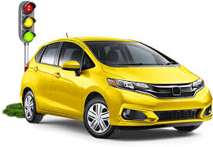

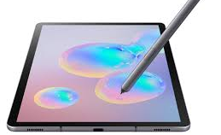

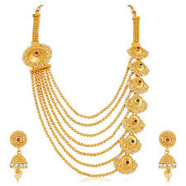
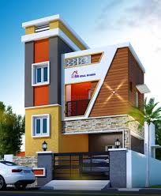
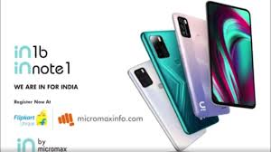
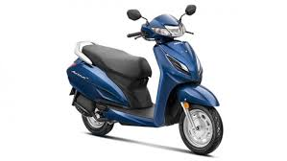
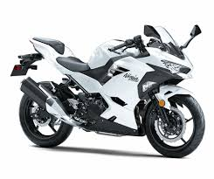
Example of Goal Settings
SHORT TERM GOALS
MID TERM GOALS
LONG TERM GOALS

Slide 14


Lets Start Learning
Learning is very important
Its make the Process easy
Its make you confident
Its make you professional
Its create a success path for you
IF YOU REALY WANTS TO EARN THEN ALWAYS READY TO LEARN
“For effective LEARNING
Most Important Task is to
make yourself ZERO”

Slide 15
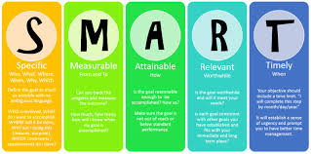



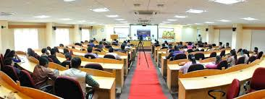








10 Core Steps
1. Define Your Dreams
2. Book/CD/Seminar
3. 100% Products Use
4. List Building
5. Contact & Inviting
6. Show the Plan
7. Get Started
8. Counselling with Upline
9. Accountability
10. L T D

Slide 16
13 - Essentials
Set the Priority
Sense of Urgency
No Dependency
Dream Exercise
Develop Business Mindset
Create a Momentum & Maintain the Momentum
Go Getter
Focus Working
9. 3 Closings
10. Go One Step Ahead
11. Analysis of Last Month
12. Transparent & Strong Communication
13. Help down lone to do all above 12 points

Slide 17
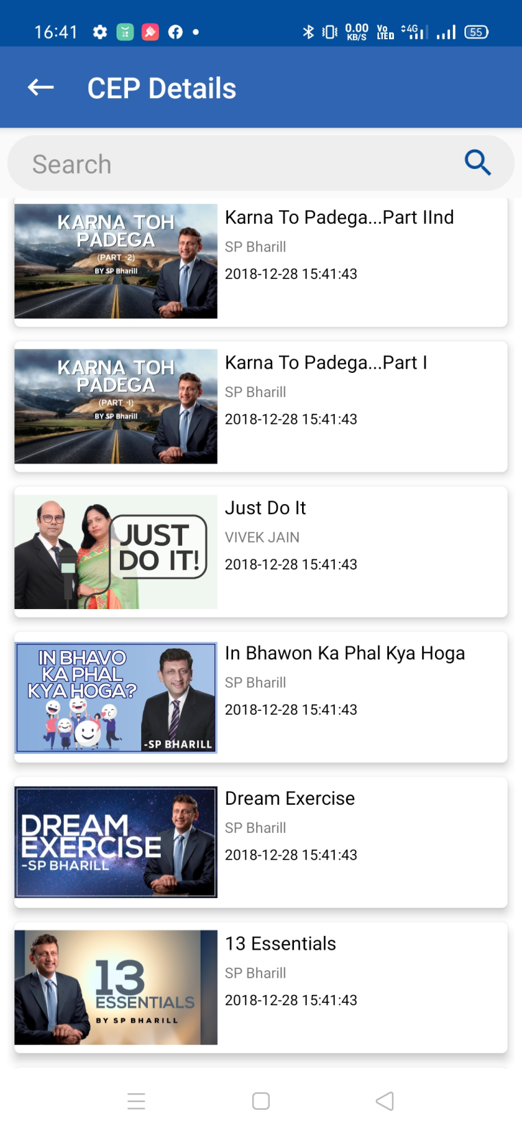
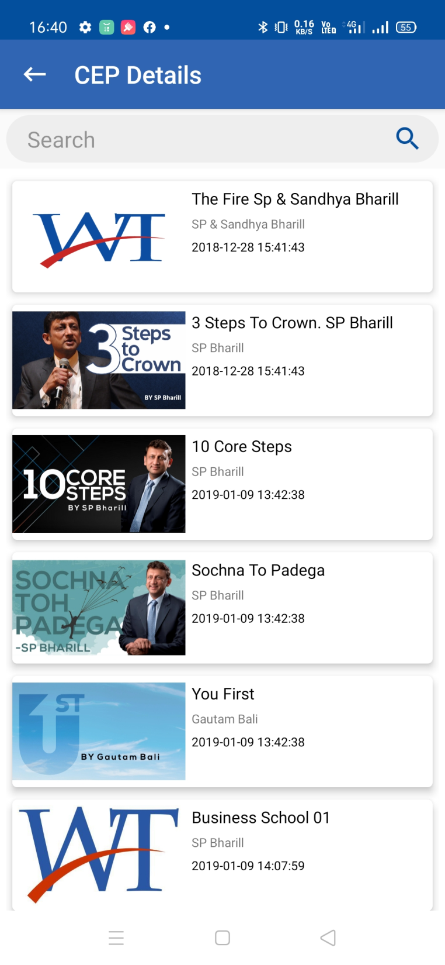
Important CD’s / Videos
The Fire
Sochna to Padega
Karna to Padega
You First
Business ke Nut Bolt P-1
Business ke Nut Bolt P-2
Dram Exercise
10 Core Steps
3 Steps to Crown
13 Essentials
Think Fundamental Grow Rich

Slide 18
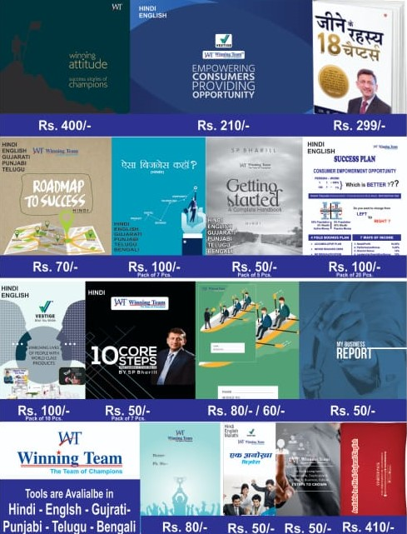
Important Books / Tools must have

Slide 19



RPPT Formula and Law of Average
Low of Average
100% # 80%E - 20%R
Right Person
Right Place
Right Time

Slide 20
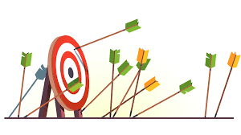


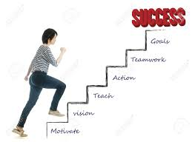






Be Prepared for These Things
Mistakes
Failures
Insult
Frustration
Rejection
Learning's
Success Step
Big Respect
High Desires
Celebrity Step

Slide 21






BONANZA TRIP TO
GOA
This TRIP can do a Miracle with your CHEQUE !!

Slide 22
BRONZE DIRECTOR GROWTH WITH 5625 PV IN A MONTH
Application
CEP
3 Steps to Success CD
150 PV
Go-Getter Structure
3 Month Trip Magic
You
1200 PV
800 PV
2400 PV
875 PV
100 PV
100 PV
Total Income in
3 Months
Rs. 75000/-
With 2 Tickets to
WT Goa Trip
1st Month Total PV = 5625
2nd Month Total PV = 8425
3rd Month Total PV = 16850
PB = 2800x18x4% = Rs. 2016/-
PB = 2800x18x4% = Rs. 2016/-
PB = 5625x18x4%
= Rs. 4050/-
BBB = 2800x6%+5625X5%
= (168+282)x18x0.83/-
= Rs. 6723/-
BBB = 2800x6%+8425X5%+5625 x4% = 815x18x0.83 = Rs. 12176/-
Bronze Director
BDB = 5625X18X6%
= 6075x1.33/-
= Rs. 8080/-
Silver Director
Gold Director
TF = 14670x0.25 = Rs. 3668/-
TBB = 8100x0.37 = Rs. 2997/-
LOB = 8425X5%+5625x4% = 11646x1.85 = Rs. 21545/-
LOB = 5625x18X5%x1.85/-
= Rs. 9365/-
TBB = 6075x0.37 = Rs. 2448/-
Cheque = 4050+8080+2448
= Rs. 14578/-
Cheque = 2016+12176+3668+
21545 = Rs. 39405/-
Cheque = 2016+6723+2997
+9365/- = Rs. 21101/-

Slide 23
SILVER DIRECTOR GROWTH WITH WT GOA TRIP
Application
CEP
3 Steps to Success CD
150 PV
Go-Getter Structure
3 Month Trip Magic
You
5625 PV
800 PV
900 PV
650 PV
200 PV
100 PV
Silver Director = 8425 PV
1st Month
Performance Bonus = 2800x18x4% = Rs. 2016/-
Business Building Bonus = 2800x6%+5625X5% = (168+282)x18x0.83/- = Rs. 6723/-
Team Building Bonus = 8100x0.37 = Rs. 2997/-
Leadership Bonus = 5625x18X5%x1.85/- = Rs. 9365/-
Total Cheque = 2016+6723+2997+9365/- = Rs. 21101/-

Slide 24
SILVER DIRECTOR GROWTH WITH WT GOA TRIP
Application
CEP
3 Steps to Success CD
150 PV
Go-Getter Structure
3 Month Trip Magic
You
Silver
2800 PV
5625 PV
900 PV
650 PV
500 PV
600 PV
Bronze
5625 PV
Gold Director = 16850 PV
2nd Month
Performance Bonus = 2800x18x4% = Rs. 2016/-
Business Building Bonus = 2800x6%+8425X5%+5625 x4% = 815x18x0.83 = Rs. 12176/-
Travel Fund = 14670x0.25 = Rs. 3668/-
Leadership Bonus = 8425X5%+5625x4% = 11646x1.85 = Rs. 21545/-
Total Cheque = 2016+12176+3668+ 21545 = Rs. 39405/-

Slide 25
SILVER DIRECTOR GROWTH WITH WT GOA TRIP
Application
CEP
3 Steps to Success CD
150 PV
Go-Getter Structure
3 Month Trip Magic
You
2800 PV
2800 PV
5625 PV
650 PV
500 PV
600 PV
5625 PV
Total Income in
3 Months
Rs. 156500/-
With 2 Tickets to
WT Goa Trip
2800 PV
5625 PV
3rd Month
Star Director = 33700 PV
5625 PV
Performance Bonus = 2800x18x4% = Rs. 2016/-
B.B. Bonus = 2800x6%+11225X5%+14050 x4%+5625x3% = 26280x0.83 = Rs. 21812/-
Travel Fund = 26280x0.25 = Rs. 6570/-
Leadership Bonus = 11225X5%+14050x4%+ 5625 x3% = 23256x1.85/- = Rs. 43024/-
Scheme Fund = 26280x0.50 = Rs. 13140/-
Car Fund = 26280x0.36 = Rs. 9461/-
Total Cheque = 2016+21812+6570+43024+ 13140+9461 = Rs. 96023/-

Slide 26
GOLD DIRECTOR GROWTH WITH WT GOA TRIP
1st Month
3 Month Trip Magic
2nd Month
3rd Month
Total Income in
3 Months
Rs. 265000/-
with 2 Tickets
to Goa Trip
You
1000
You
2000
You
2800
A
2800
2800
D
800
800
2800
4000
Star Director
A
2800
2800
D
A
2800
2800
D
J
B
5625
B
Diamond Director
B
F
2800
5625
F
1625
B
5625
E
1000
B
2800
5625
2800
2800
K
5625
E
B
2800
E
C
C
5625
C
5625
H
2800
G
5625
G
5625
L
M
Total PV = 19650
5625
I
Total PV = 33700
Total PV = 53325
Rs. 45000/- to
Rs. 50000/-
Rs. 90000/- to
Rs. 100000/-
Rs. 120000/- to
Rs. 130000/-

Slide 27
STAR DIRECTOR GROWTH WITH WT GOA TRIP
1st Month
3 Month Trip Magic
2nd Month
3rd Month
You
You
2000
Total Income in
3 Months
Rs. 370000/-
with 2 Tickets
to Goa Trip
2800
2001
5625
You
2800
A
2800
2800
D
800
A
2800
J
K
J
2800
2800
D
2800
4000
B
2800
B
A
2800
2800
D
J
F
Diamond Director
4000
F
2800
B
2800
5625
2800
Crown Director
B
5625
E
B
2800
E
2800
K
F
1625
5625
C
5625
C
B
2800
2800
E
2800
K
5625
H
2800
1625
5625
G
5625
H
C
G
5625
L
2800
5625
M
G
5625
L
I
5625
M
Total PV = 33700
5625
I
Total PV = 53325
Total PV = 60951
Rs. 90000/- to
Rs. 100000/-
Rs. 120000/- to
Rs. 130000/-
Rs. 140000/- to
Rs. 150000/-

Slide 28
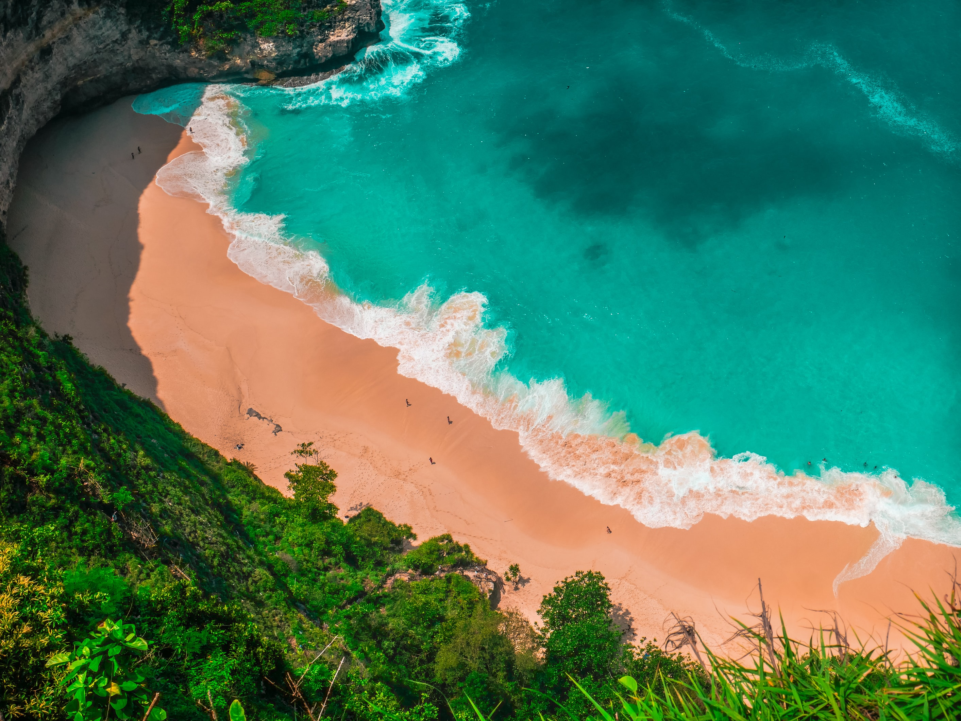

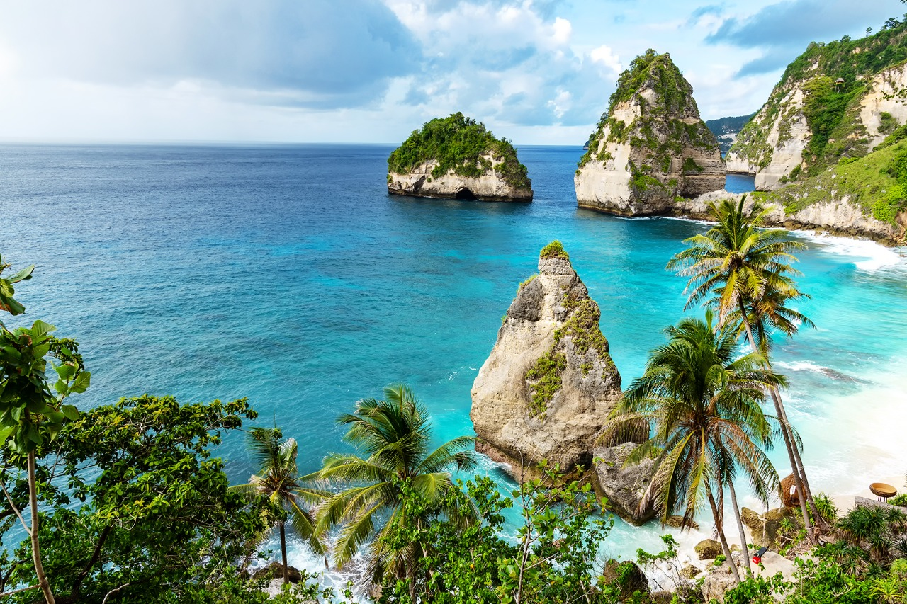
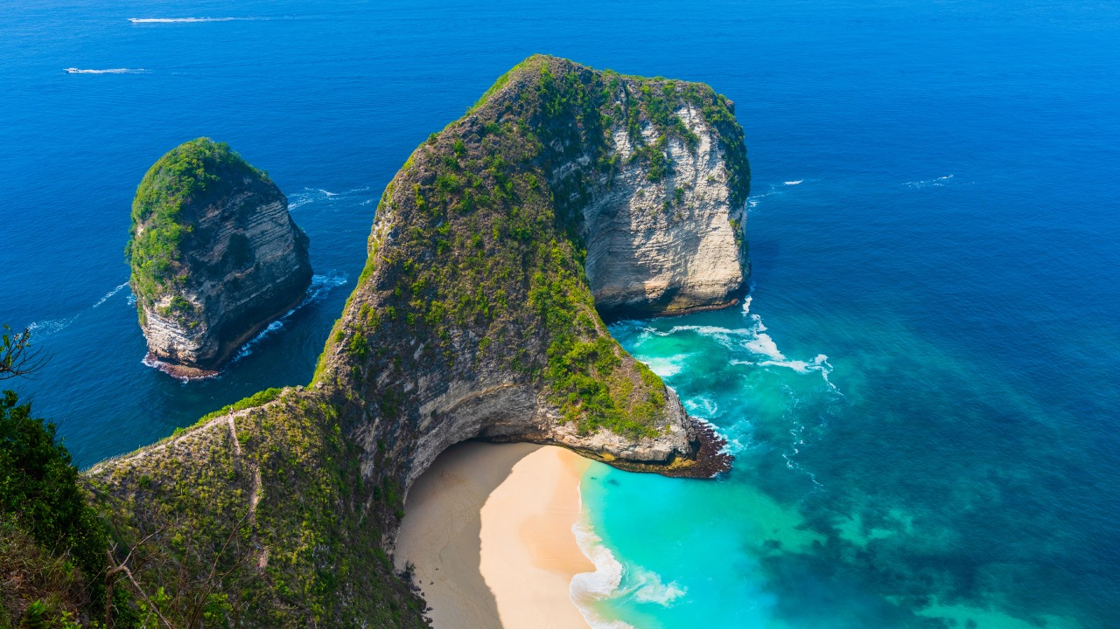
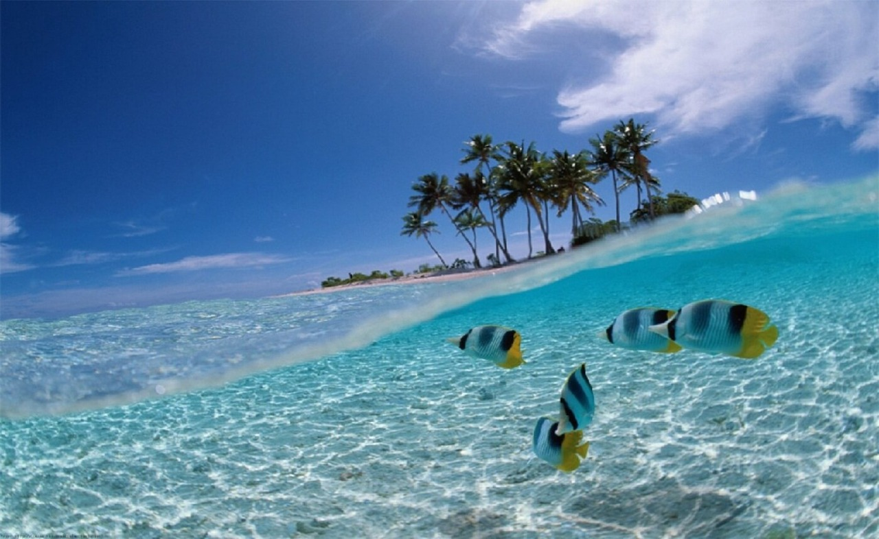
WLS TRIP
TO
BALI

Slide 29





Lets Create History in Direct Selling through Vestige with WT

